Slide 1


’S e àm na Càisge a th’ ann.
Notes:
It’s Easter time.

Slide 2




Dè bhios a’ chlann a’ dèanamh?
Notes:
What will the children be doing?

Slide 3
Bidh Anna aig an taigh còmhla ris an teaghlach ag ithe dinnear shònraichte.
Notes:
Anna will be at home with the family eating a special dinner.

Slide 4
Bidh Sìne anns an eaglais ag ùrnaigh.
Notes:
Sìne will be in the church praying.

Slide 5
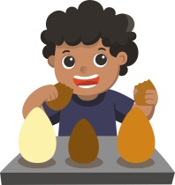
Bidh Calum ag ithe ugh seòclaid.
Notes:
Calum will be eating a chocolate egg.

Slide 6
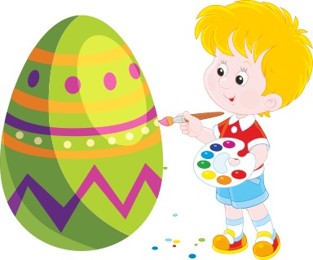
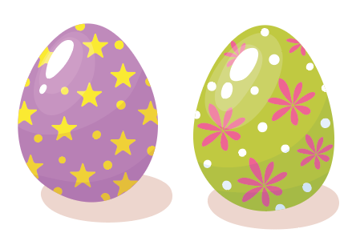
Bidh Pòl a’ peantadh uighean.
Notes:
Pòl will be painting eggs.

Slide 7
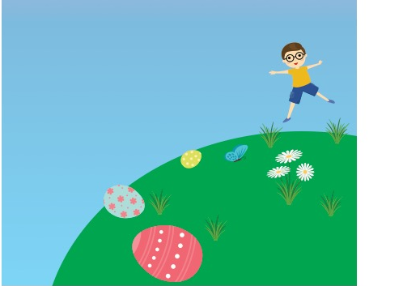
Bidh Marc a’ roiligeadh uighean sìos an cnoc.
Notes:
Marc will be rolling eggs down the hill.

Slide 8
Dè bhios tusa a’ dèanamh aig àm na Càisge?
Notes:
What will YOU be doing at Easter time?

